Slide 1

Excited States and Nonadiabatic Dynamics
CyberTraining School/Workshop 2023
Alexey Akimov
University at Buffalo, SUNY
June 11, 2023

Slide 2
General Workshop Goals
and
Overview of the CyberTraining Infrastructure

Slide 3
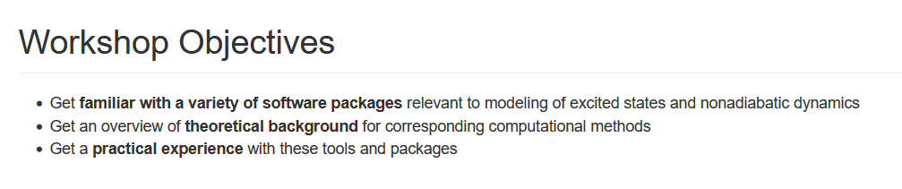

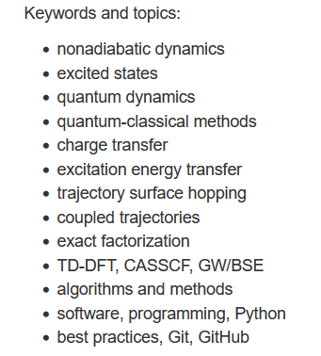
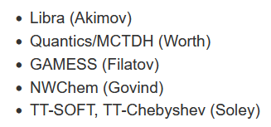
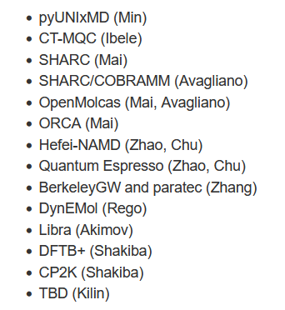
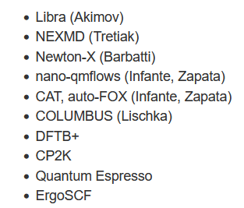
Objectives and Agenda
CyberTraining: Pilot: Modeling Excited State Dynamics in Solar Energy Materials
This year
2022 (in person/virtual)
2021 (virtual)

Slide 4
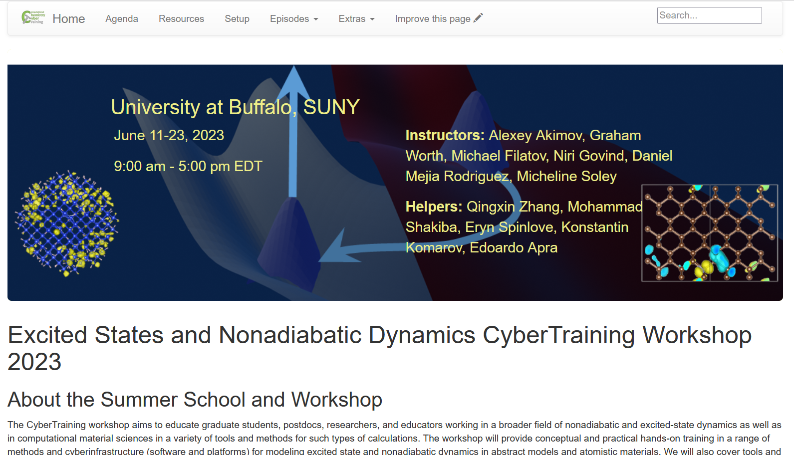
The Plan & Resource
All the details are here:
https://compchem-cybertraining.github.io/Cyber_Training_Workshop_2023
Join Slack:
Members can invite new members
Private and public channels, direct (private) messages, conversations
Any time, no strings attached
https://join.slack.com/t/quantumdynamicshub/shared_invite/zt-mjbhjssx-GGhsbYHxeBMvhmumK_j7LA
VPN and Accounts:
2-factor authentication
submit a ticket: https://ubccr.freshdesk.com/support/home

Slide 5
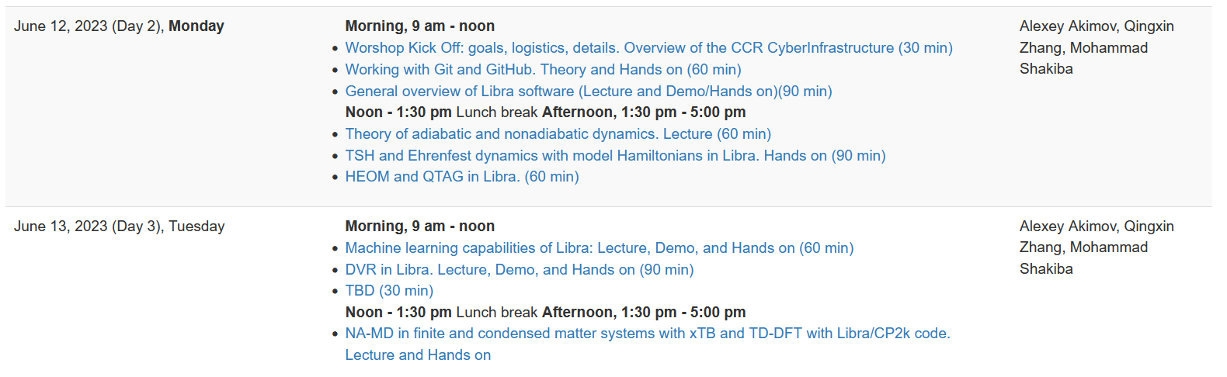

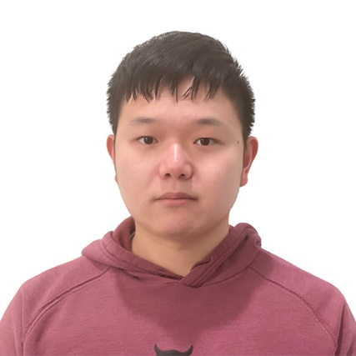
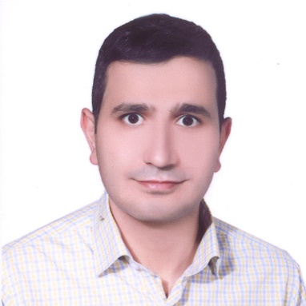
Topics and Instructors
Libra
https://github.com/Quantum-Dynamics-Hub/libra-code
https://compchem-cybertraining.github.io/Cyber_Training_Workshop_2023/_episo des/03-libra
https://github.com/compchem-cybertraining/Tutorials_Libra
https://github.com/compchem-cybertraining/Tutorials_DFTB_plus
Mohammad Shakiba
https://github.com/compchem-cybertraining/Tutorials_CP2K
Alexey Akimov
Qingxin Zhang

Slide 6
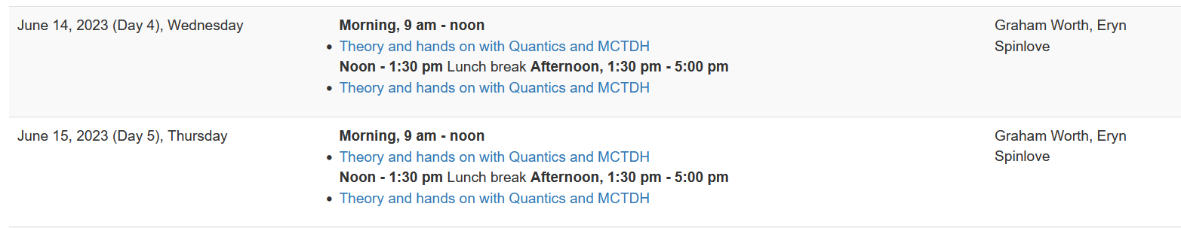

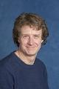
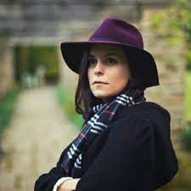
Topics and Instructors
Quantics
http://www2.chem.ucl.ac.uk/quantics/
https://compchem-cybertraining.github.io/Cyber_Training_Workshop_2023/_episodes/04-quantics
https://github.com/compchem-cybertraining/Tutorials_Quantics
Graham Worth
Eryn Spinlove

Slide 7
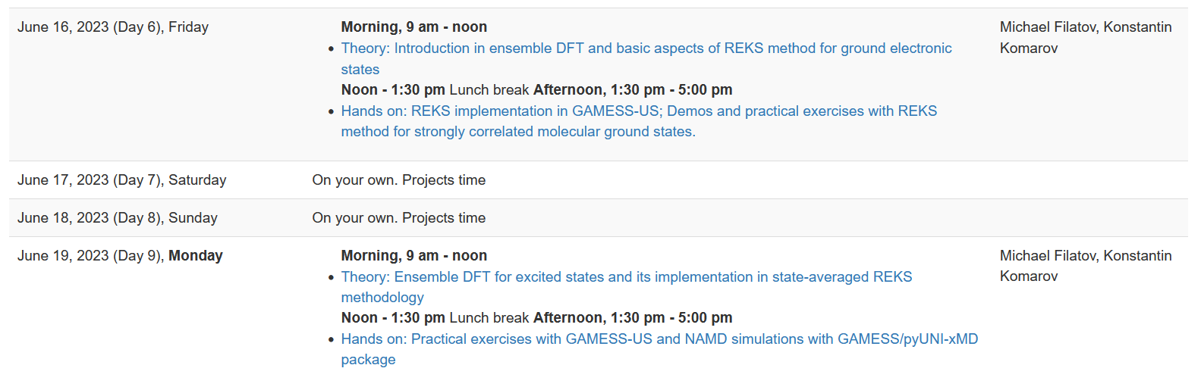
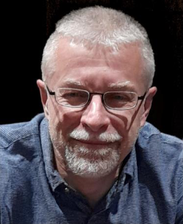
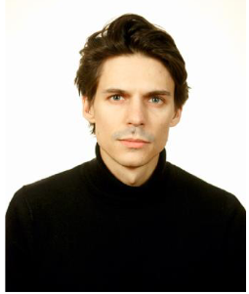
Topics and Instructors
GAMESS US
https://www.msg.chem.iastate.edu/gamess/
https://compchem-cybertraining.github.io/Cyber_Training_Workshop_2023/_episodes/05-gamess
https://github.com/compchem-cybertraining/Tutorials_GAMESS
Konstantin Komarov
(remotely)
Michael Filatov (Gulak)

Slide 8
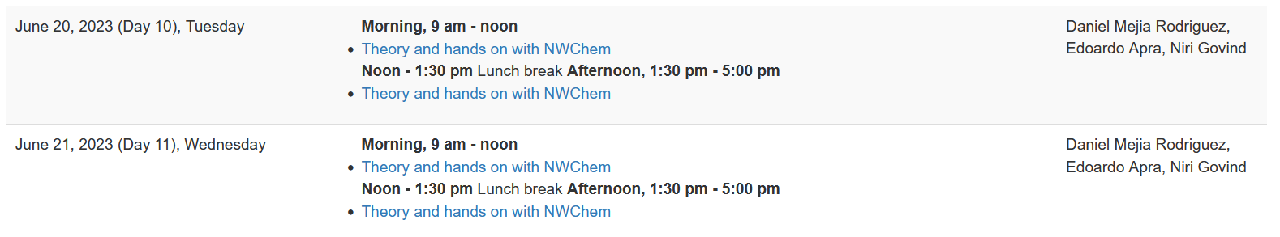
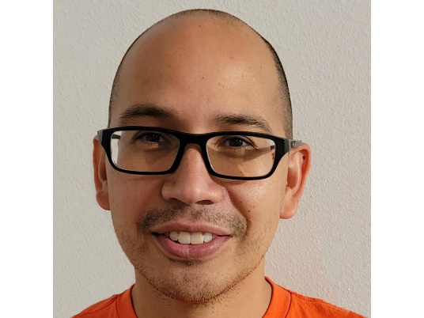
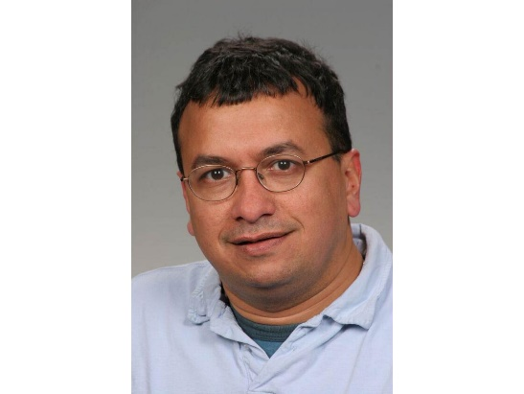
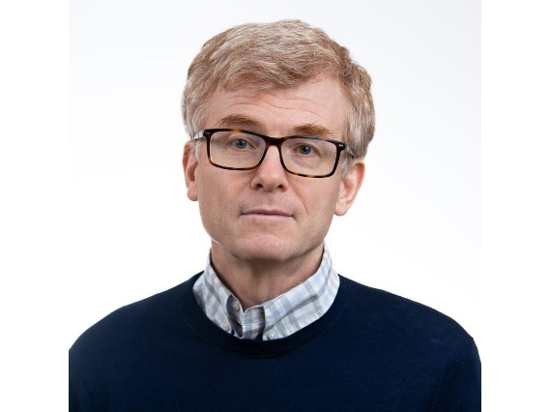
Topics and Instructors
NWChem
https://www.nwchem-sw.org/
Daniel Mejia-Rodriguez
Niri Govind (remotely)
Edoardo Apra (remotely)
https://compchem-cybertraining.github.io/Cyber_Training_Workshop_2023/_episodes/06-nwchem
https://github.com/compchem-cybertraining/Tutorials_NWChem

Slide 9
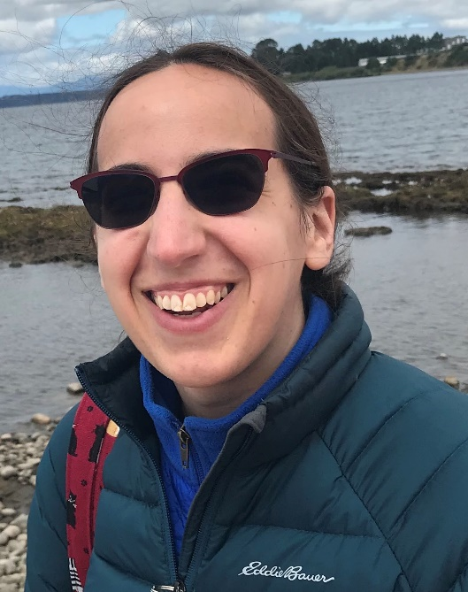
Topics and Instructors
TT-SOFT and TT-Chebyshev
https://compchem-cybertraining.github.io/Cyber_Training_Workshop_2023/_episodes/07-ttsoft
https://github.com/compchem-cybertraining/Tutorials_NWChem
Micheline Soley

Slide 10
Please Introduce Yourself
Name, position, affiliation, research group
Research interests and expertise
Anything else you would like to share with us

Slide 11
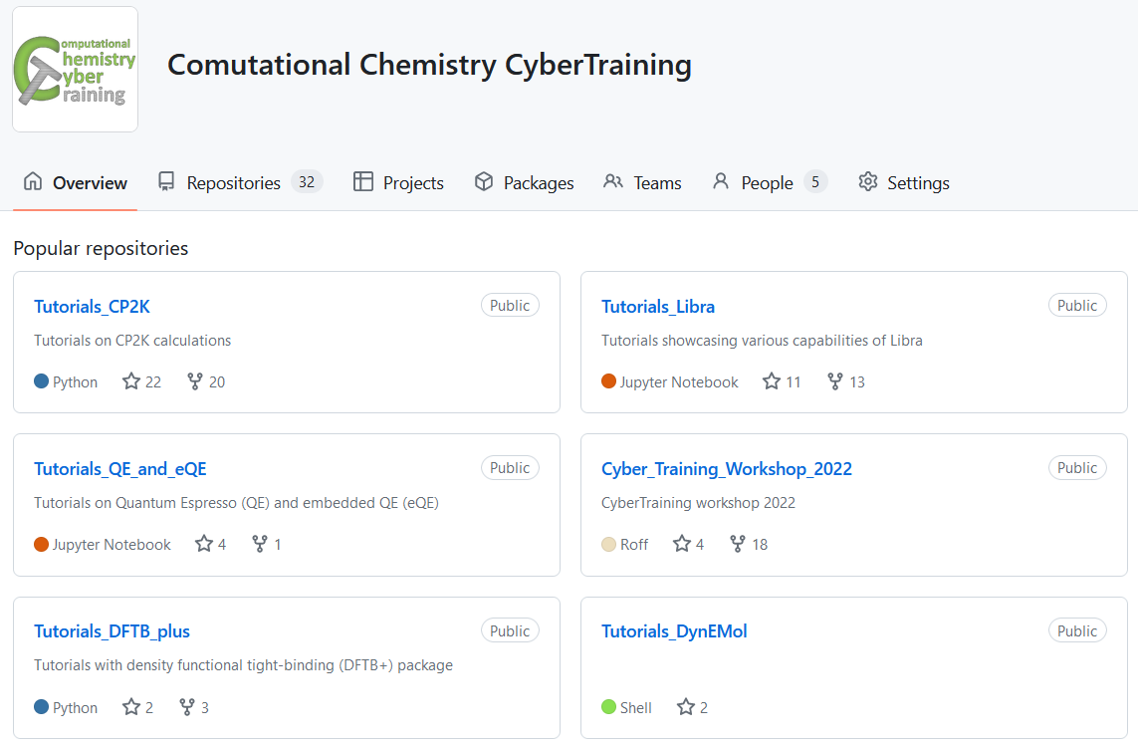
More Resources
Codes: https://github.com/Quantum-Dynamics-Hub
Training: https://github.com/compchem-cybertraining
Quantum Dynamics Hub: https://quantum-dynamics-hub.github.io/
Summer 2021 workshop: https://compchem-cybertraining.github.io/Cyber_Training_Workshop_2021/
Libra Winter school: https://compchem-cybertraining.github.io/Libra_Winter_School_2022/
Summer 2022 workshop: https://compchem-cybertraining.github.io/Cyber_Training_Workshop_2022/
Summer 2023 (This!) workshop: https://compchem-cybertraining.github.io/Cyber_Training_Workshop_2023/

Slide 12
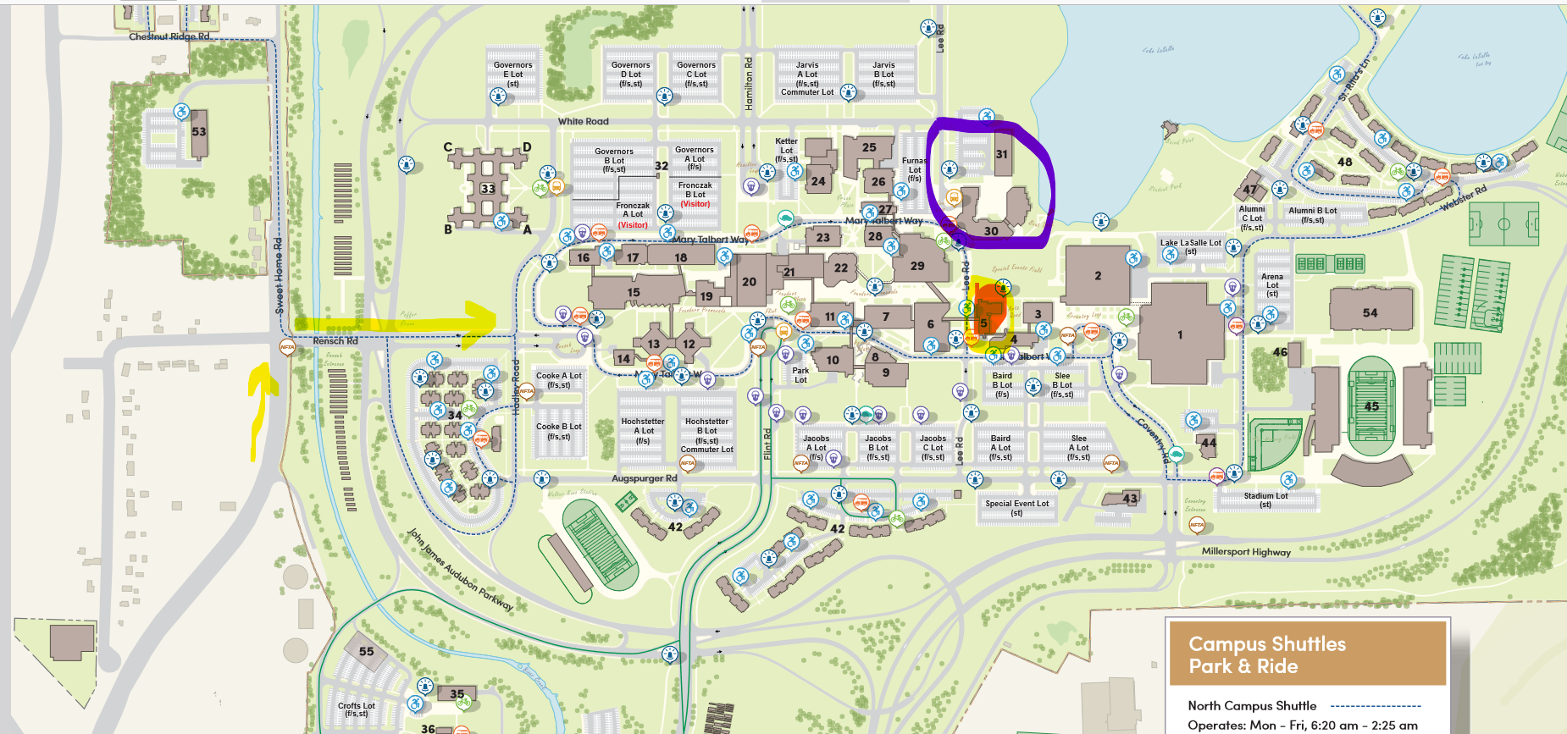
Daily Schedule
Daily
Breakfast = hotel
9:00 am – 12:00 pm: Morning session (Recording)
12:00 – 1:30 pm Working lunch/rest – on your own at “Commons”, rest, discuss, collaborate
1:30 pm – 5:00 pm: Afternoon session (Recording)
After 5:00 pm: collaborations/on your own, dinner on your own
Location
Classes are @: June 12 – 22 Clemens 120
Lunch
Campus Map: https://emergency.buffalo.edu/content/dam/www/parking/North%20Campus%20Parking%20Map%2011x17.pdfhttps://emergency.buffalo.edu/content/dam/www/parking/North%20Campus%20Parking%20Map%2011x17.pdf
Classes
Your Hotels

Slide 13
Logistic
We cover your hotel stay (except for the local folks). Stipends also cover the rest of expenses, please keep your receipts just in case. Let me know your flight expenses via the Google form provided on Slack channel.
Travel for the US participants to a reasonable amount, partially the international participants (as the funds allow), except for local/UB-affiliated folks.
Paperwork: All trainees will need to fill in the RF Participation Stipend form and one of the other two forms: W-9 - for the US residents and W-8BEN for the non-residents. The forms are distributed to you via Slack – please DON’t sent them back via e-mail – upload to the form provided or via Slack.
A lot of paperwork later – likely it’ll be just me handling most of the stuff
Prizes: $300 (1 first prize), $200 (3 second prizes), $100 (5 first prizes) – the project competition. Online and in-person participants are eligible. UB-affiliated participants are eligible too.
Reimbursement/honoraria to the instructors – a separate paperwork. Will send you instructions via the Instructors Channel on Slack.

Slide 14
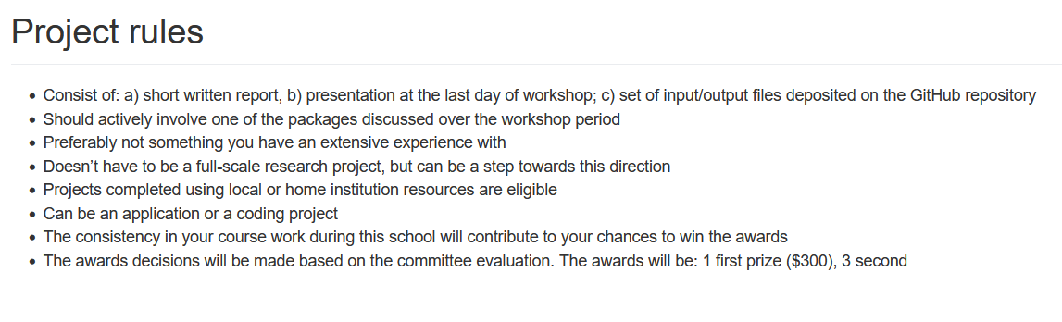
Course Project
https://compchem-cybertraining.github.io/Cyber_Training_Workshop_2023/CODE_OF_CONDUCT.html
Submit your project via GitHub by June 30
Oral presentation – tentatively July 1-2, via Zoom
Check out the past years’ projects:
https://github.com/compchem-cybertraining/Cyber_Training_Workshop_2021/tree/gh-pages/course_work
https://compchem-cybertraining.github.io/Cyber_Training_Workshop_2021/_episodes/13-projects
https://github.com/compchem-cybertraining/Cyber_Training_Workshop_2022/tree/gh-pages/course_work
https://compchem-cybertraining.github.io/Cyber_Training_Workshop_2022/_episodes/15-projects

Slide 15
Getting Started on UB CCR

Slide 16
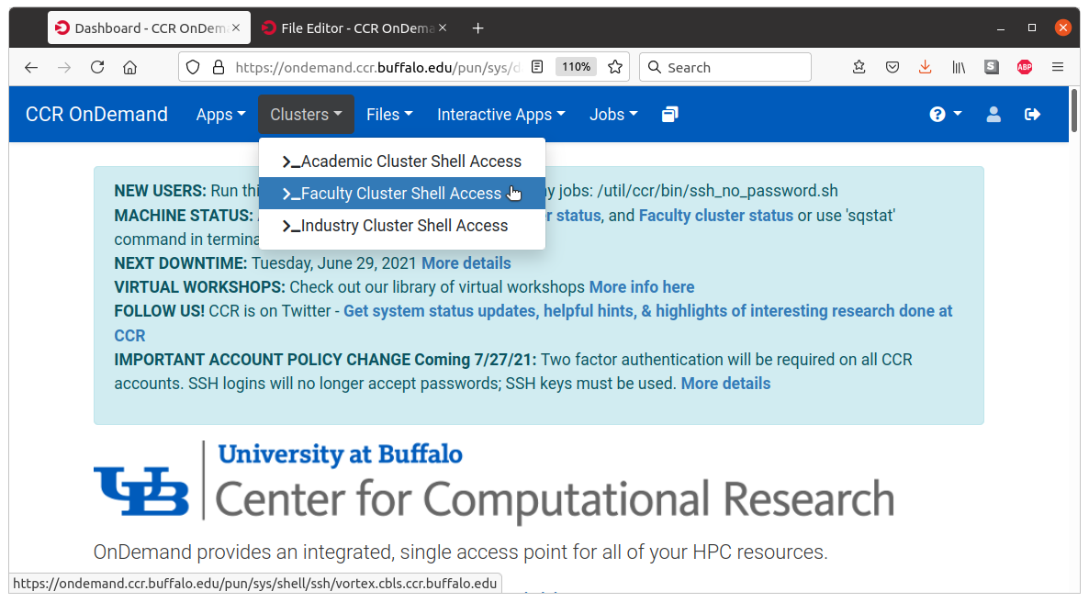
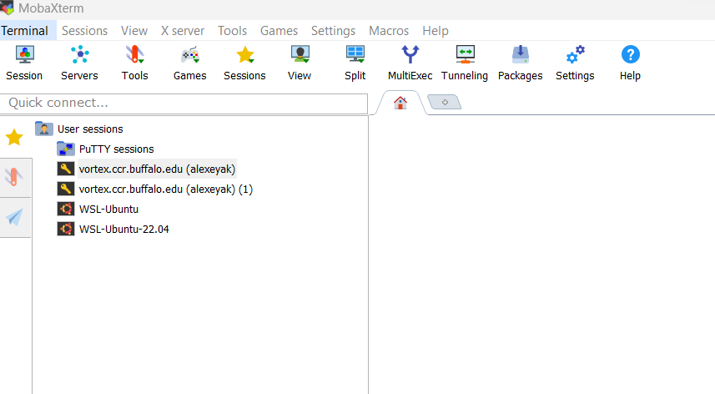
Accessing UB Computing Resources
Before the Workshop
https://compchem-cybertraining.github.io/Cyber_Training_Workshop_2023/setup.html
https://compchem-cybertraining.github.io/Cyber_Training_Workshop_2023/_episodes/01-introduction
OnDemand (not Firefox, use Chrome)
On campus – nothing special;
Off-campus – use UB VPN
https://ondemand.ccr.buffalo.edu/
Moba Xterm
Generate the SSH public/private key.
Use Moba Tools -> MobaKeyGen
Coordinate it with your UB credentials
https://docs.ccr.buffalo.edu/en/latest/portals/idm/

Slide 17
Accessing UB Computing Resources
Your .bashrc file (in your home directory)
# .bashrc
# User specific aliases and functions
# Source global definitions
if [ -f /etc/bashrc ]; then
. /etc/bashrc
fi
module use /projects/academic/cyberwksp21/Modules
eval "$(/projects/academic/cyberwksp21/SOFTWARE/Conda/bin/conda shell.bash hook)"
Restart terminal or `source .bashrc`
For terminal-based operations: Activate conda environment: `conda activate libra2`
For Jupyter – just launch it
Projects directory: /projects/academic/cyberwksp21 - slower, smaller, but permanent
Scratch space: /panasas/scratch/grp-cyberwksp21 - faster, larger, but temporarily (unused files are cleaned up every 1 or 2 weeks)

Slide 18
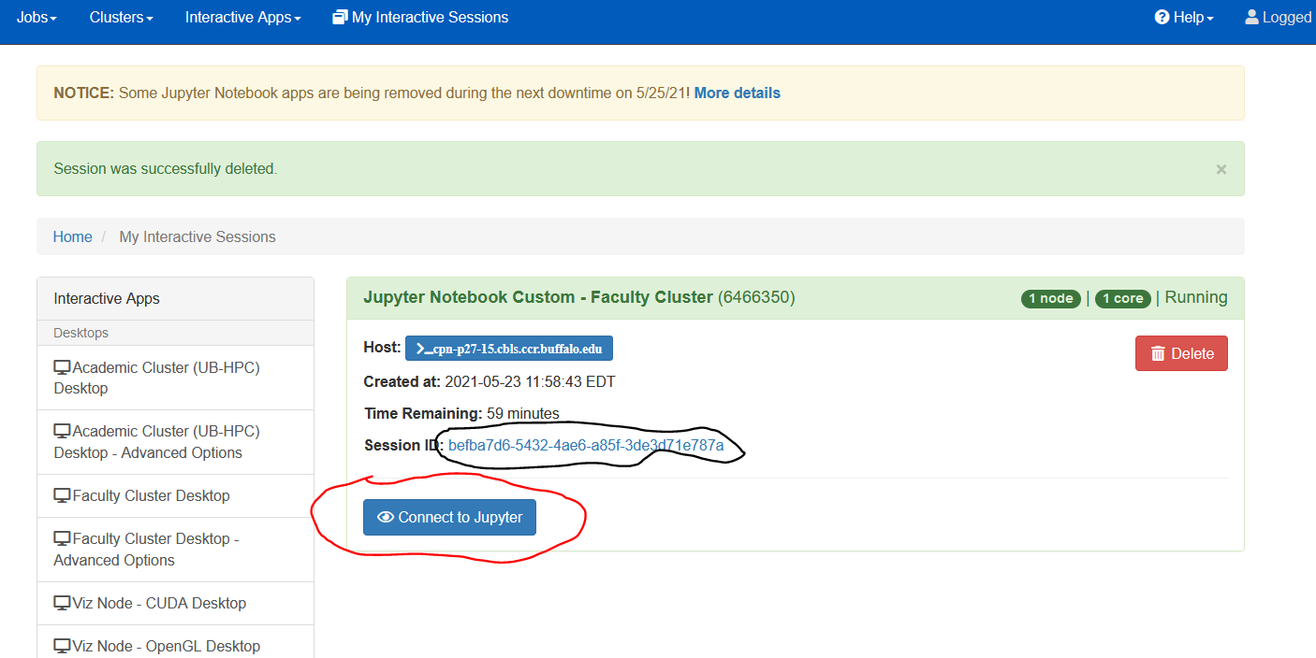
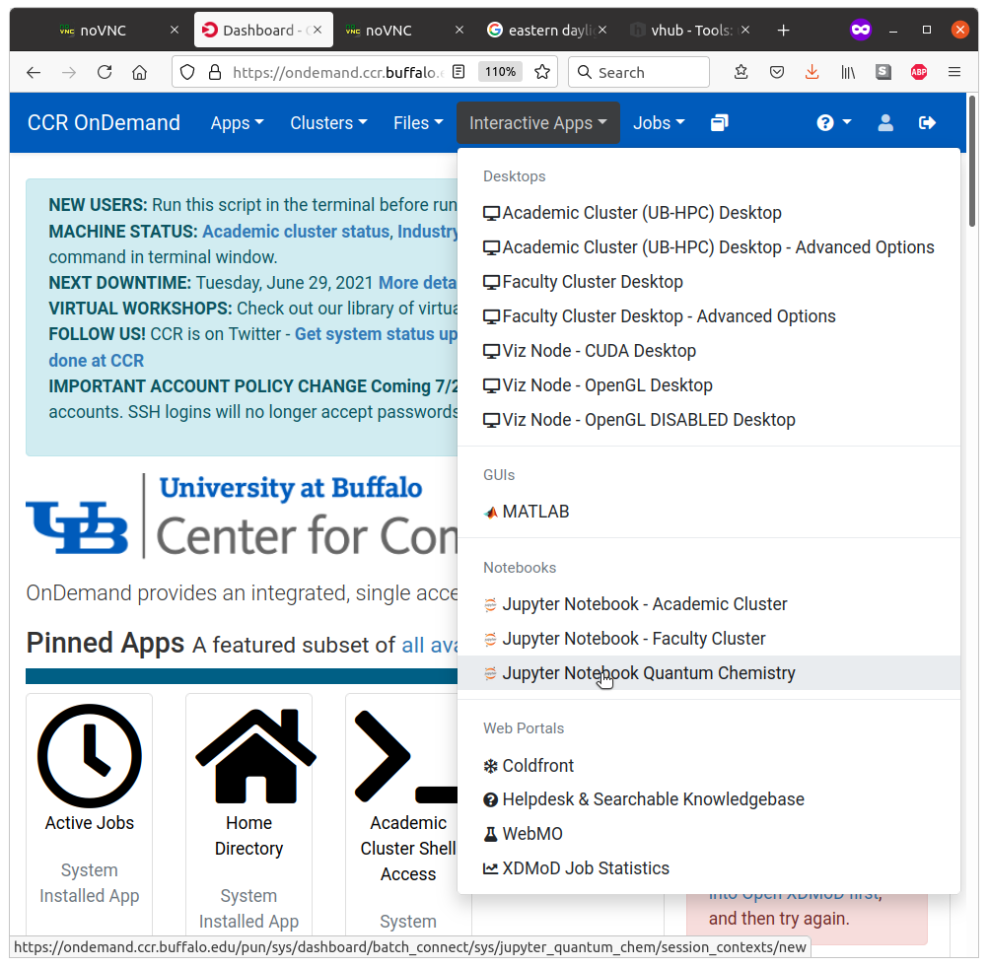
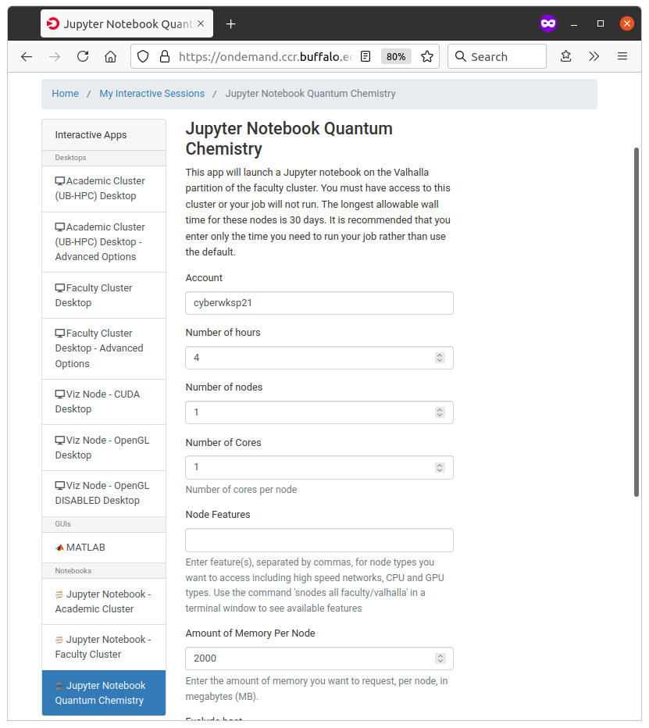
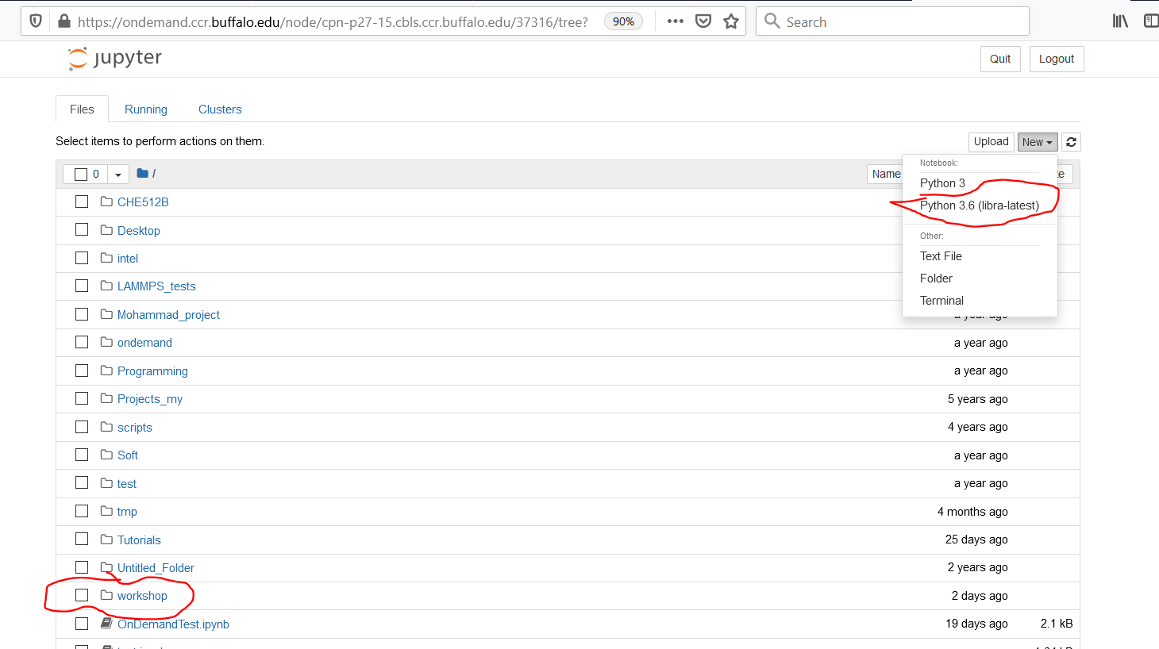
Using Jupyter Notebooks
https://compchem-cybertraining.github.io/Cyber_Training_Workshop_2023/_episodes/01-introduction

Slide 19
GitHub & Git
Overview

Slide 20
Git and GitHub Workflow
“fork”
Official Remote
“Upstream”
User Remote
”Upstream”
GitHub
Pull-request
git pull
git clone
git pull
git clone
git push
git push
git pull
git clone
Local Repo
“Downstream”
Local Repo
“Downstream”
Local Machine

Slide 21
Libra overview

Slide 22

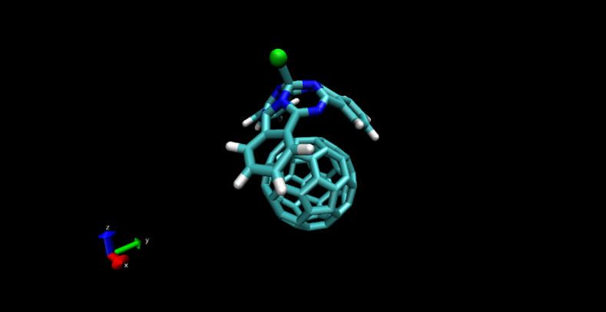
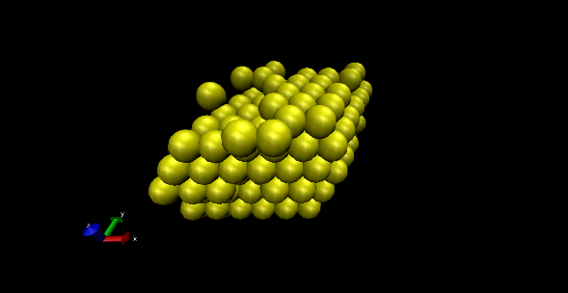
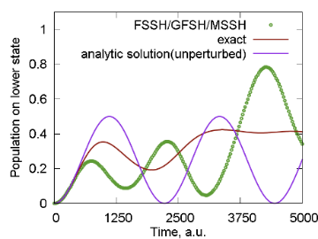
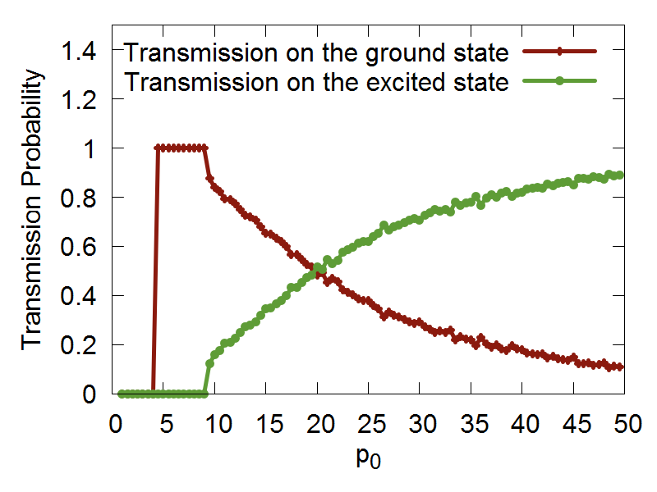
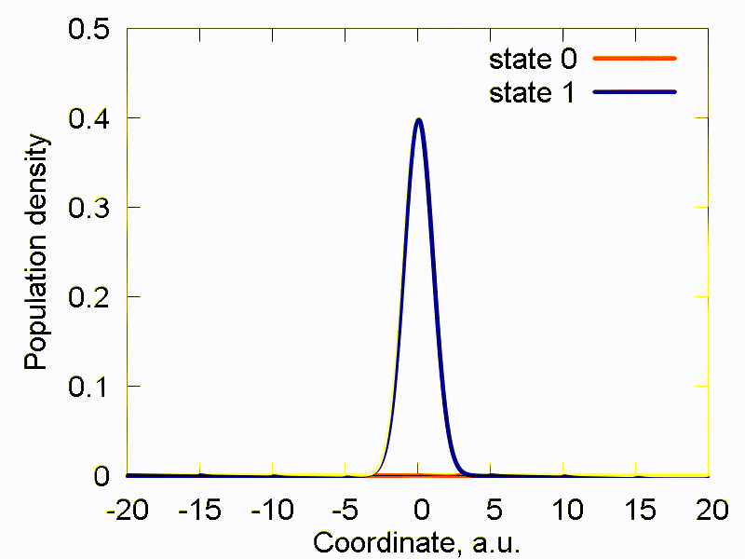
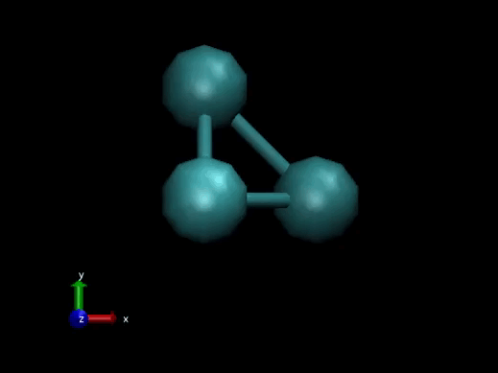
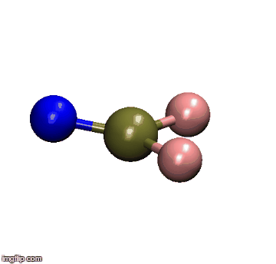
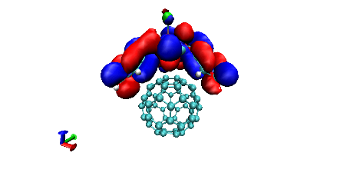
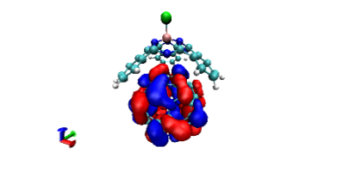
Libra History
Classical MD
Libra-X (with Drs. Ryoji Asahi, Kosuke Sato, Ekadashi Pradhan)
Sato, Pradhan, Asahi, Akimov PCCP 2018, 20, 25275
Pradhan, Sato, Akimov J. Phys.: Condens. Matter, 2018, 30, 484002
Interfaces with GAMESS, QE
Added back-reaction for QE
More modularization
Akimov, Prezhdo, JCTC, 2013, 9, 4959.
Akimov, Prezhdo, JCTC, 2014, 10, 789
Akimov JCC, 2016, 37, 1626
Ehrenfest & TSH
DVR
Back-reaction
Rigid body MD
Simplectic integrators for classical DOFs
Thermostats
Barostats
Force fields
ANN
Chemical object representation
Modularization and revision
DVR methods
Semiempirical Hamiltonians
Molecular integrals
Decoherence methods, TSH
Simplectic integrators for TDSE
TSH, Ehrenfest, stand-alone scripts
Decoherence methods
Model problems
Added HF and EHT to LCCCS
Interface with VASP, then QE
Pyxaid2 (with Prof. Wei Li)
Li, Zhou, Prezhdo, Akimov ACS Energy Lett, 2018, 3, 2159
SOC, multiple k-points, etc.
2007-2011
(LCCCS)
2011-2015
(Pyxaid)
2015/2016
(Libra)
2018
(Pyxaid2, Libra-X)

Slide 23
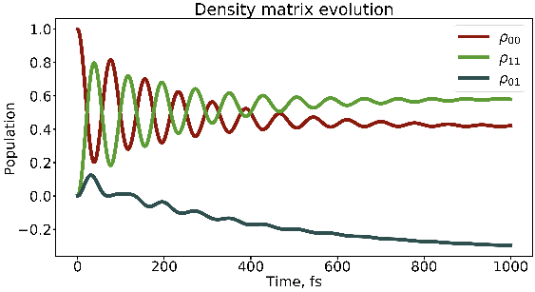
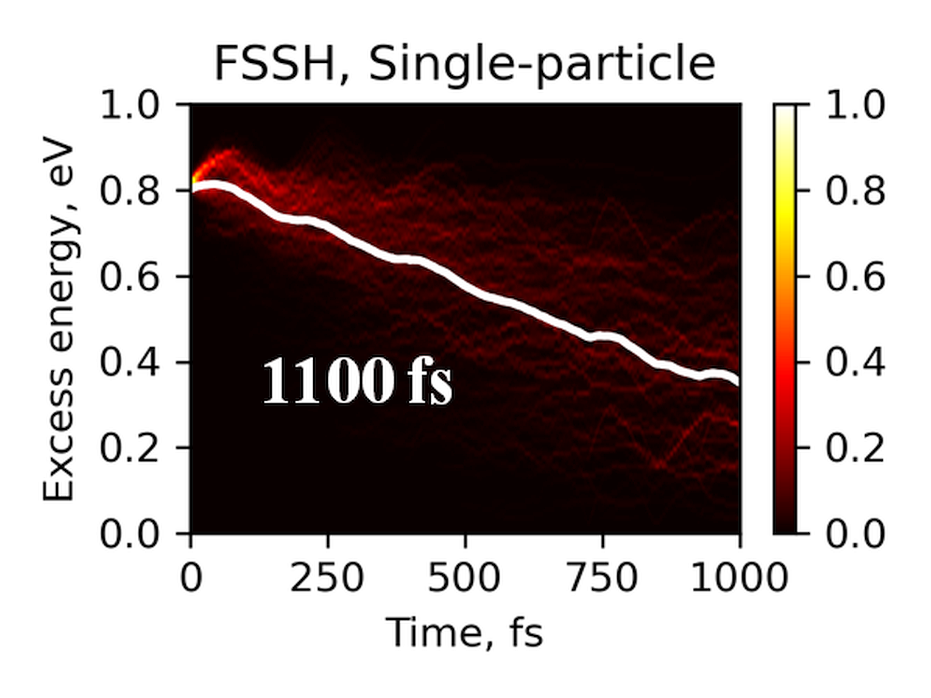
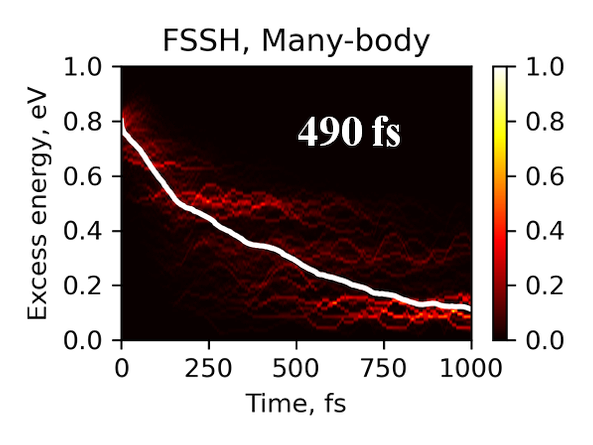
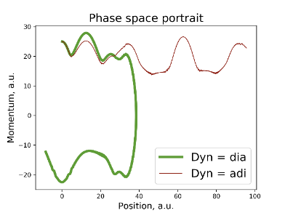
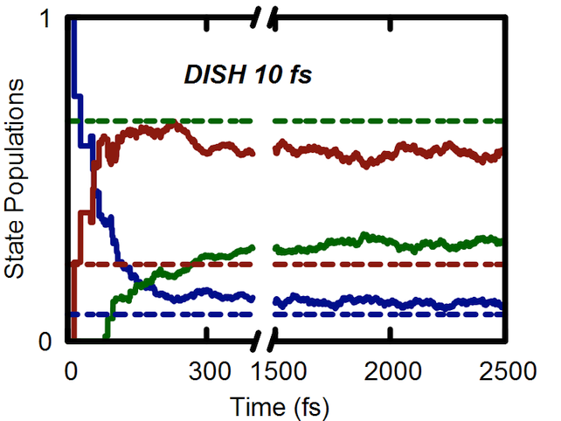
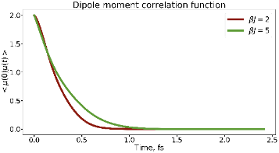
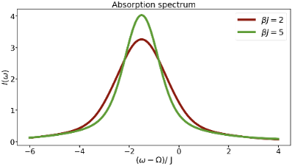
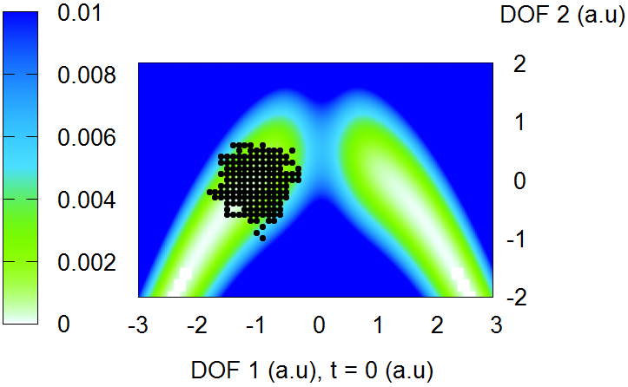
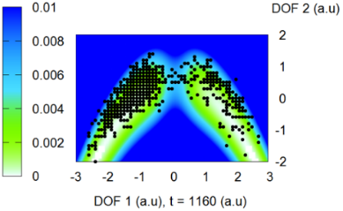
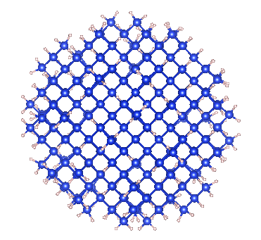
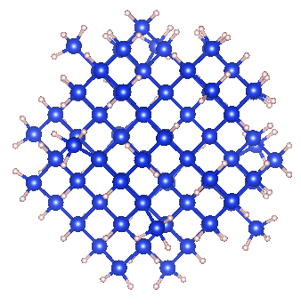
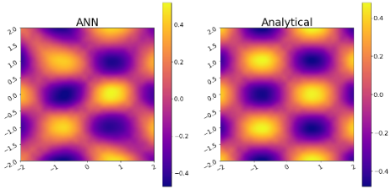


Libra History
Bastida’s Boltzmann-corrected Ehrenfest, mSDM
HEOM
Many-body NA-MD
Phase correction for NACs
Temen, Jain, Akimov Int. J. Quant. Chem., 2020, 120, e26373
Smith, B.; Shakiba, M.; AVA JCTC 2021, 17, 678
Smith, B.; Shakiba, M.; AVA JPCL 2021, 12, 2444
Akimov JPCL 2018 9, 6096-6102
Smith; Akimov JCP 2019, 151, 124107
Revised DISH, new workflows
Akimov JCP 2021, 155, 134106
Entangled trajectories
Smith, Akimov JCP 2018, 148, 144106
Belyaev-Lebedev LZ method
Machine Learning revised.
TD-ML approach
Smith, B.; Akimov, A. V JPCL 2020, 11, 1456-1465
Akimov JPCL 2021, 12, 12119
2018
2019
2020
2021

Slide 24
Libra Philosophy/Vision
modular
Maximize and simplify the re-use, OOP
linear algebra, integrals,
quantum and classical mechanics/dynamics,
nonadiabatic methods, surface hopping,
IO utilities, model preparation and analysis
versatile
“methodology discovery”
Use with model problems and atomistic simulations
Python – for convenience, C++ - for efficiency
(prototyping)
practical
Fully-functional tool that can be applied to real (atomistic) systems to study materials
user-friendly & documented
The code is convenient to users and they have plenty resources – examples and documentation
A platform to adopt the past and latest developments
The developers can understand and contribute to the code
community tool
Notes:
So that is what Libra is essentially about..
To give you a more practical idea of how these design principles are implemented, lets discuss several modules..

Slide 25
Libra Motivation
Many codes (Newton-X, SHARC, NEXMD, FIERBALL, JADE, MOLPRO, PYXAID, PYUNIXMD, …)
Black-box. Difficult to re-use to formulate other methods, etc.
Limited functionality (high focus, e.g. atomistic of special kind)
Many methods (FSSH, DISH, A-FSSH, QTAG, QTSH, etc.)
Not always available
Not always user-friendly (e.g. my experience with PYXAID prototype)
Not always portable/modular, lack of best coding standards, no version control, etc.
Limited consistency of different codes
Possible redundancies even in the same code

Slide 26
Libra Motivation
Adopt the best practices
Modularity (e.g. PySCF, Psi4NumPy, PyQuante, HORTON)
Language standards (Python, C++ vs. Fortran? Hybrid programming)
Testing & Documentations (pytest, unittest, Doxygen/Sphinx)
User/developer training (Workshops, Summer/Winter schools)
Focus on the community
Every group has expertise in their field – rely on that
Community contributions – PR on GitHub
Use version control and collaborative workflows via GitHub, Issues
Frequent communication and close collaboration e.g. via Slack

Slide 27
Community Tool: Code Contributions/Integration
Amber Jain – Hierarchical Equations of Motion (HEOM)
src/dyn/heom
https://github.com/amber-jain-group-iitb/heom_amber
Xiang Sun – (Non)-equilibrium Fermi Golden Rule (FGR)
src/fgr
https://github.com/tsiangsun/FGR
Nandini Ananth – Initial value representation (IVR)
src/ivr
https://github.com/AnanthGroup/SC-IVR-Code-Package
Sophya Garaschchuk – quantum trajectory guided Gaussians (QTAG)
src/libra_py/dynamics/qtag
Craig Martens – quantum trajectory surface hopping (QTSH)
in progress
… and more

Slide 28











Practical: Libra in Materials Research
2D systems
2D heterojunctions
Auxiliary Analysis Tools
Long el al. JPCL 2016, 7, 653.
Nijamudheen, A.; AVA JPCC, 2017, 121, 6520
Perovskites
Quantum Dots & Molecules
Organic heterojunctions
Nijamudheen, A.; AVA JPCL 2018, 9, 248
Lin, Y.; AVA JPCA. 2016, 120, 9028
Sato et al. PCCP, 2018, 20, 25275.
Pradhan et al. JPCM, 2018, 30, 484002

Slide 29


C++/Python Interoperability
C++ layer
Python layer
User-Customized & Library
Python functions
Call by C++
Eigen 3
libra_py
Prototype and
Test (Discover)
Translate code
Use in C++ codes
Use in Python codes

Slide 30
Modularity: API Diversity
The goal is to suite the needs of the users of various levels
Find a balance between simplicity and flexibility
Developer/Efficiency
double gaussian_overlap( AO* AOa, AO* AOb,int is_normalize, int is_derivs, VECTOR& dIdA, VECTOR& dIdB, vector<double*>& auxd,int n_aux);
double gaussian_overlap( AO* AOa, AO* AOb,int is_normalize, int is_derivs, VECTOR& dIdA, VECTOR& dIdB );
double gaussian_overlap(AO* AOa, AO* AOb,int is_normalize);
double gaussian_overlap(AO* AOa, AO* AOb);
User/Convenience

Slide 31
Example
Computing kinetic energy between Gaussians
g1 = PrimitiveG()
g2 = PrimitiveG()
g1.init(n1,m1,k1, a1, VECTOR(x1, y1, z1))
g2.init(n2,m2,k2, a2, VECTOR(x2, y2, z1))
kin = kinetic_integral(g1,g2)
Benchmarked against PyQuante
p1 = PyQuante.PGBF.PGBF(a1,(R1.x,R1.y,R1.z),(n1,m1,k1))
p2 = PyQuante.PGBF.PGBF(a2,(R2.x,R2.y,R2.z),(n2,m2,k2))
val_ref = p1.kinetic(p2)

Slide 32

Passing Python functions
C++
Python
Models
Implementation
Interface

Slide 33
How it works with Sampling
vector<MATRIX> metropolis_gau
(Random& rnd, bp::object target_distribution,
MATRIX& dof, bp::object distribution_params,
int sample_size, int start_sampling, double gau_var){
Metropolis Algorithm
double p_old =
bp::extract<double>( target_distribution(s_old, distribution_params) );
…
}
def test():
q = MATRIX(ndof, 1)
output = metropolis_gau( piab, q, params, ...)
User calls the sampling
Output
def piab(q, params):
User defines the
probability density
C++
Python

Slide 34
Example
q = MATRIX(1,1); q.set(0, 0.5)
params = {"k":1.0, "m":2000.0, "states":[0], "coeffs":[1.0]}
Nsamp = 1000000; Nstart = 50000
sampling = metropolis_gau(rnd, HO_sup, q, params, Nsamp,Nstart, 0.05)
bin(sampling, -1.5, 2.0, 0.01, 0, 0, "_distrib-1.txt")
User defines how to
run the MC sampling
def HO_sup(q, params):
k = params["k"]; m = params["m"];
states = params["states"]; coeffs = params["coeffs"]
x = q.get(0)
sz = len(states)
p = 0.0
for n in xrange(sz):
p = p + coeffs[n] * ket_n(x, states[n], k, m)
p = p * p
return p
User defines what
probability distribution
function is to be sampled
The dynamical algorithm is in C++, but…
Don’t need to implement the model in C++

Slide 35


















Initial Conditions: Metropolis Sampling
Particle in a box
Harmonic oscillator
$$ψ_{n}\left(q\right)\sim \sin\left(\frac{πnq}{L}\right)$$
$$ψ_{n}\left(q\right)\sim H_{n}\left(q\sqrt{α}\right)\exp\left(−\frac{αq^{2}}{2}\right)$$
$$\left.|1\right\rangle$$
$$\left.|2\right\rangle$$
$$\left.|1\right\rangle$$
$$\left.|0\right\rangle$$
$$\left.|10\right\rangle$$
$$\left.|0\right\rangle +\left.|1\right\rangle$$
$$\left.|25\right\rangle$$
$$\left.|0\right\rangle −\left.|1\right\rangle$$

Slide 36
Why Contribute?
Make your methods broadly available (mutually advertise)
Be listed on the developers/contributors lists, get credentials, get citations
Make your methods compatible with other methods, enable easier interfacing – this facilitates new methods developments
Take advantage of other methods/functions/data types available in the same code – learn once then swim
Take advantage of improvements of other parts of the code
Mutually ensure best standards and facilitate bug discovery/testing

Slide 37

How to Contribute?
https://github.com/amber-jain-group-iitb/heom_amber
Before:
hard-coded inputs (recompile for all parameters)
Fortran into executable
After:
General-purpose code, any inputs
Python/C++, integrate with the plotting scripts, etc.
create a pull-request
open an issue
start a discussion (haven’t tried yet)

